Slide 1
Portfolio Theory II: Characteristics of Portfolios of Risky and Risk-free Assets
Dr. Natasha Todorovic

Slide 2
Risk-free asset and risk-free investing

Slide 3
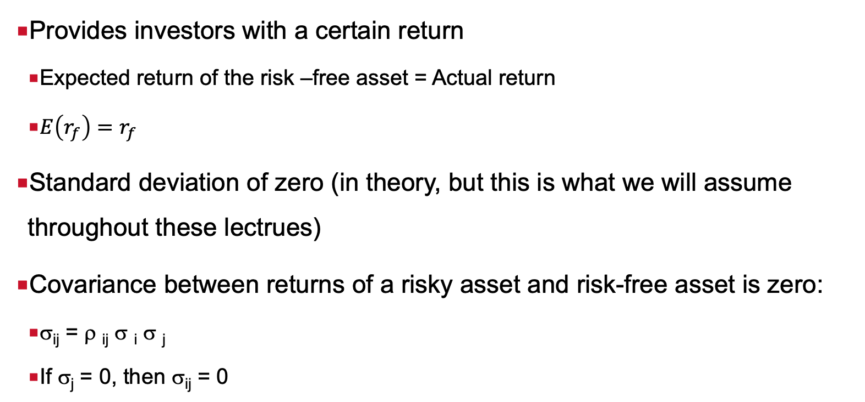
Definition of a risk-free asset
Provides investors with a certain return
  Expected return of the risk –free asset = Actual return
  $E\left(r_{f}\right)=r_{f}$
Standard deviation of zero (in theory, but this is what we will assume throughout these lectrues)
Covariance between returns of a risky asset and risk-free asset is zero:
  σ_{ij} = ρ _{ij} σ _{i} σ _{j}
  If σ_{j} = 0, then σ_{ij} = 0

Slide 4
Risk-free asset
It is a default free fixed income security without interest rate and re-investment risk
Hence, in theory, it should be a default-free fixed income security with maturity/duration matching investors investment horizon
In the application of the efficient frontier construction, we assume that risk-free asset is short term money market instrument such as T-bill

Slide 5
Investing in the risk-free asset
Risk free lending
  buying risk-free asset
Risk free borrowing
  borrowing a risk-free asset in order to short sell and use the money for investment in risky assets (borrowing at a risk-free rate)
Assumptions for risk-free borrowing:
  Borrowing rate is equal to the lending rate
  Interest rate for borrowing is known and there is no uncertainty about repaying the loan
Negative weights assigned to borrowed funds and weight greater than one is assigned to the risky asset
The sum of weights still has to be equal to 1.

Slide 6
Portfolios of one risky and one risk-free asset

Slide 7
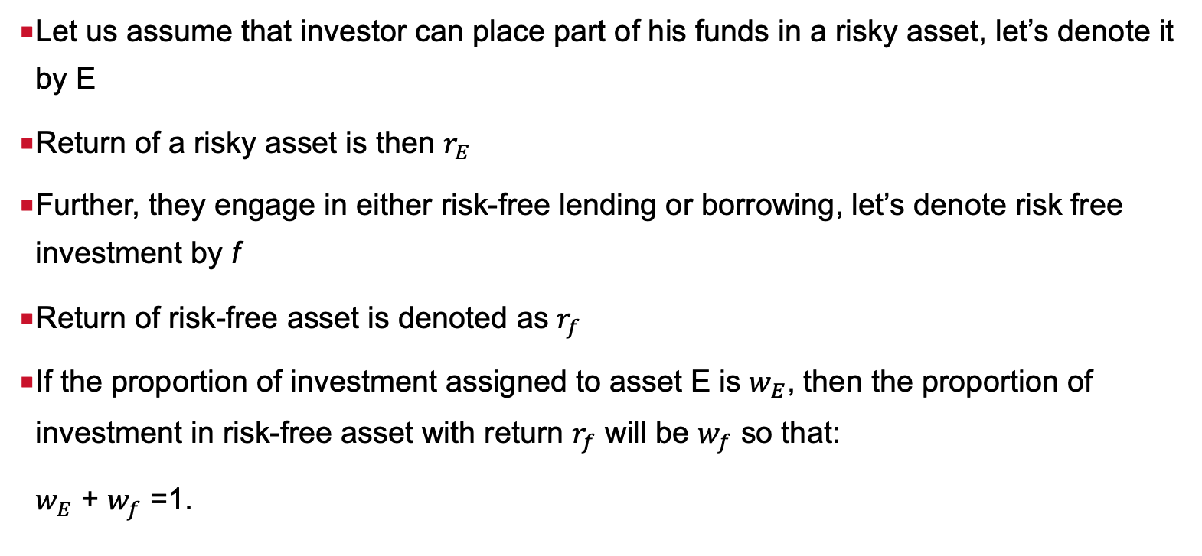
Risk and return of portfolio of one risky and a risk-free asset
Let us assume that investor can place part of his funds in a risky asset, let’s denote it by E
Return of a risky asset is then $r_{E}$
Further, they engage in either risk-free lending or borrowing, let’s denote risk free investment by f
Return of risk-free asset is denoted as $r_{f}$
If the proportion of investment assigned to asset E is $w_{E}$, then the proportion of investment in risk-free asset with return $r_{f}$ will be $w_{f}$ so that:
$w_{E}$ + $w_{f}$ =1.

Slide 8
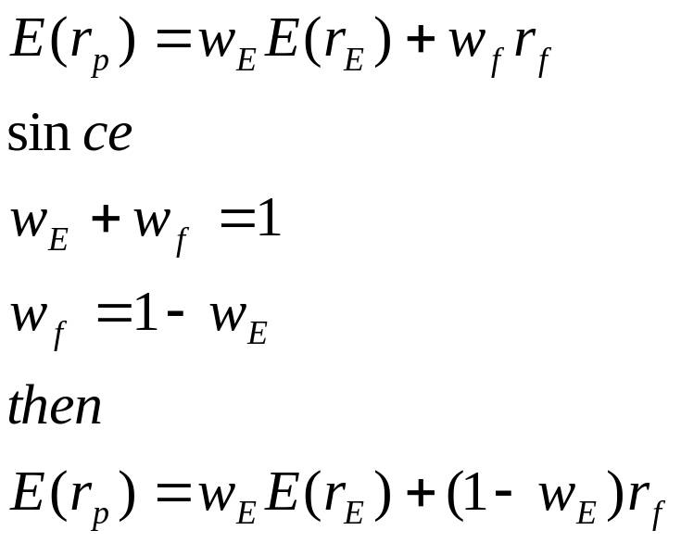
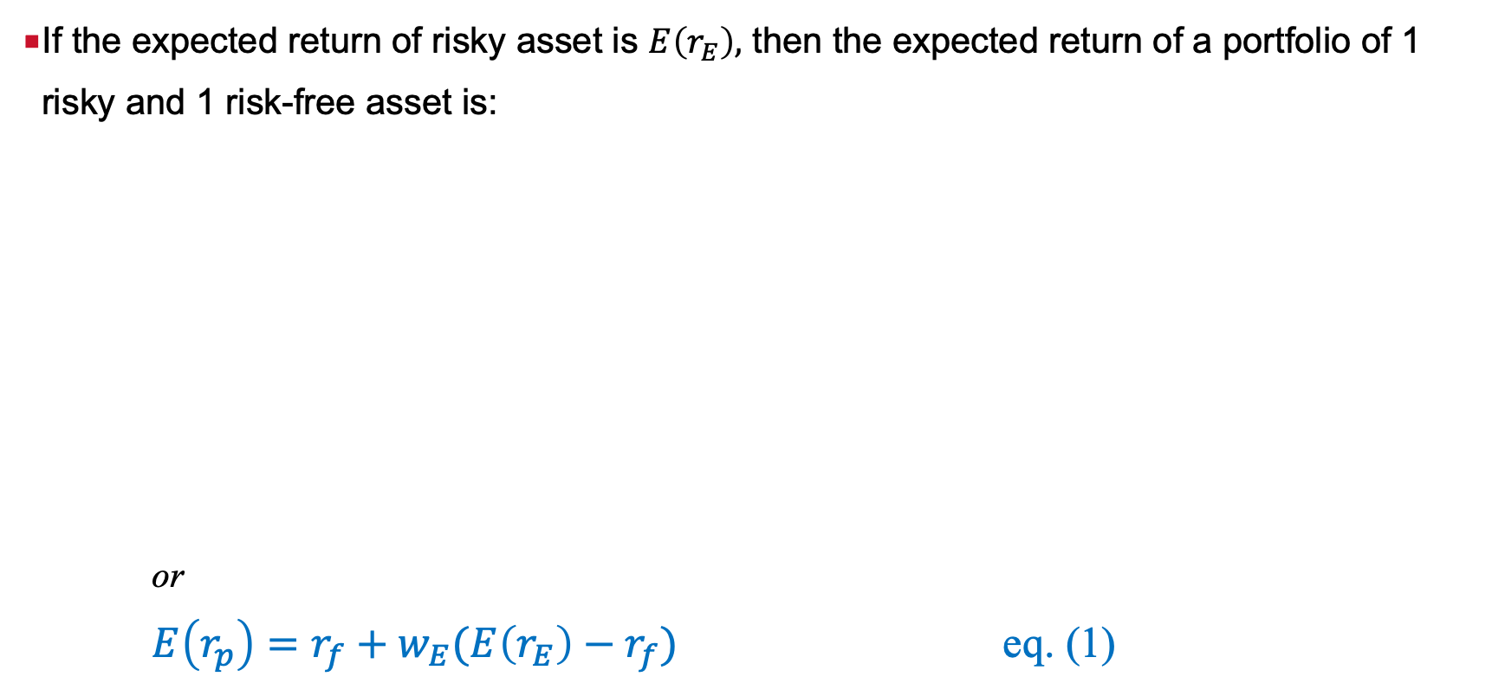
Expected return of portfolio of one risky and a risk-free asset
If the expected return of risky asset is $E\left(r_{E}\right),$ then the expected return of a portfolio of 1 risky and 1 risk-free asset is:
or
$E\left(r_{p}\right)=r_{f}+w_{E}(E\left(r_{E}\right)−r_{f})$ eq. (1)

Slide 9
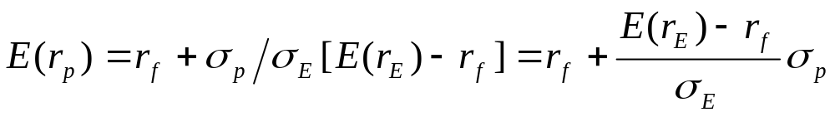
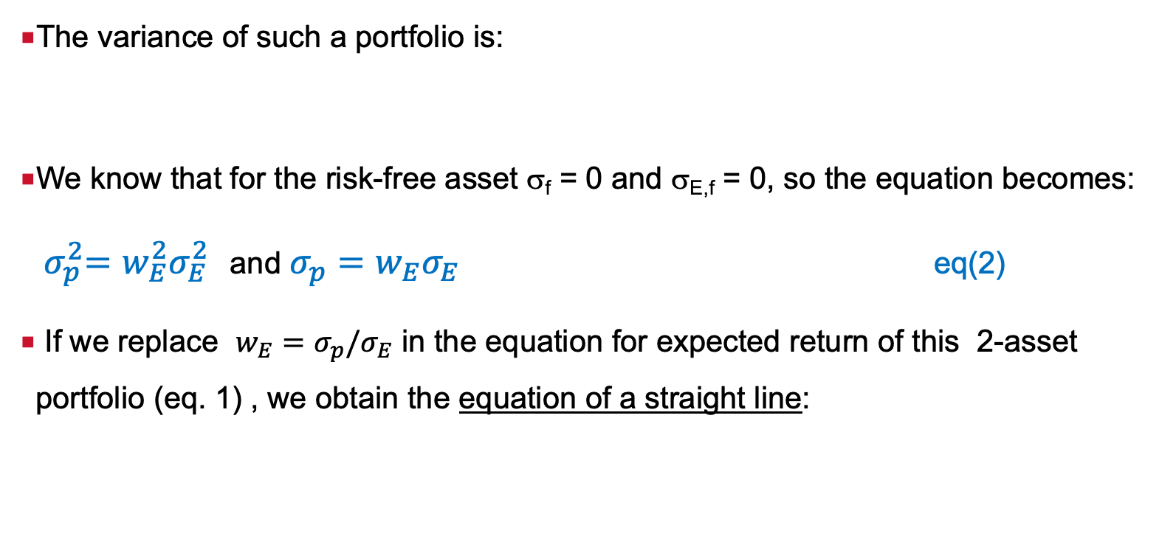
Risk of portfolio of one risky and a risk-free asset
The variance of such a portfolio is:
We know that for the risk-free asset σ_{f} = 0 and σ_{E,f} = 0, so the equation becomes:
${ σ}_{p}^{2}=w_{E}^{2}σ_{E}^{2}$ and $σ_{p}=w_{E}σ_{E}$ eq(2)
If we replace $w_{E}=σ_{p}/σ_{E}$ in the equation for expected return of this 2-asset portfolio (eq. 1) , we obtain the equation of a straight line:

Slide 10
Investing in risk-free asset and one risky asset
Consider stocks A,B and C with the following characteristics:
Exp. return Variance Covariance matrix
A B C
A 16.2 146 146 187 145
B 24.6 854 187 854 104
C 22.8 289 145 104 289
And a risk-free asset with a rate of return of 4% and variance of zero.

Slide 11
Investing in risk-free asset and one risky asset
Assume 9 portfolios, where we assign the following weights to asset A
and a risk-free asset:
exp. return and std. dev. from eq. (1) and eq. (2)
  Lending
Risky asset A only
Borrowing
Weight assigned to: |  | Expected return (%) | Standard deviation (%)
Asset A (w_{A}) | Risk-free asset (w_{f})
0 | 1 | 4 | 0.00
0.25 | 0.75 | 7.05 | 3.02
0.50 | 0.50 | 10.10 | 6.04
0.75 | 0.25 | 13.15 | 9.06
1 | 0 | 16.20 | 12.08
1.25 | -0.25 | 19.25 | 15.10
1.50 | -0.50 | 22.30 | 18.12
1.75 | -0.75 | 25.35 | 21.14
2.00 | -1.00 | 28.40 | 24.16

Slide 12
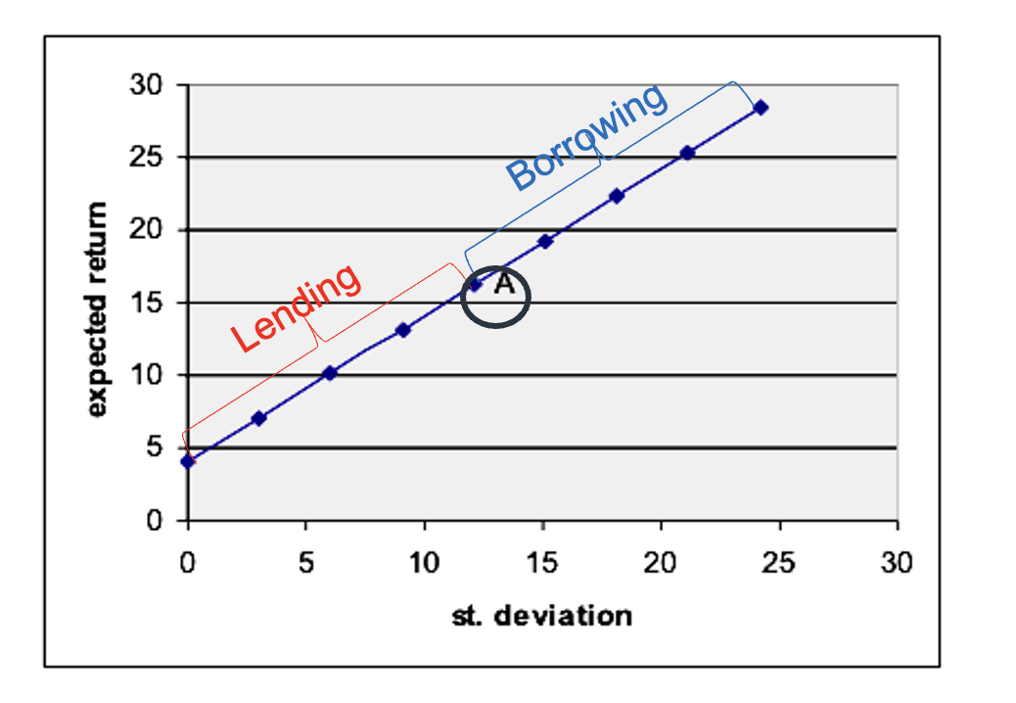
Investment in one risky and one risk-free asset: graph
All portfolios plot on the straight line, which is the efficient frontier when we have one risky and one risk-free asset

Slide 13
Portfolios of two (or more) risky and one risk-free asset

Slide 14
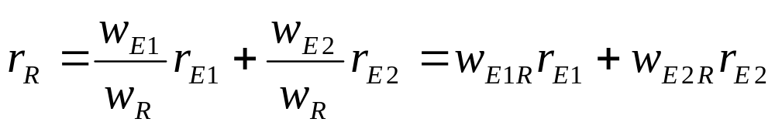
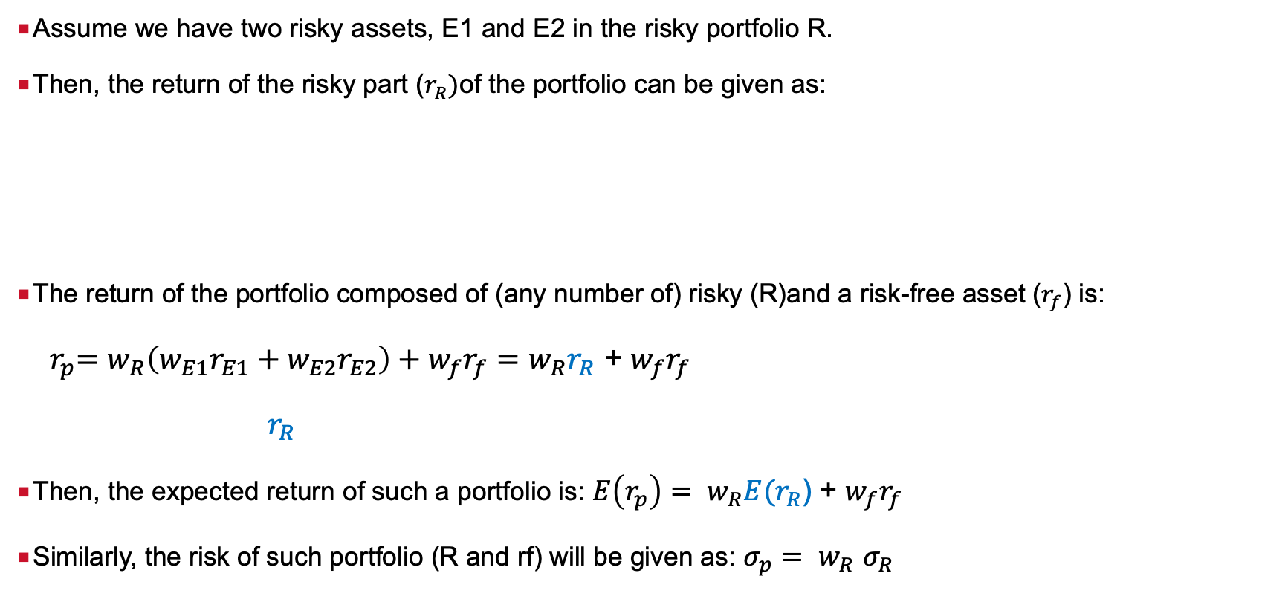
Expected return and risk of portfolios of any number of risky assets and one risk-free asset
Assume we have two risky assets, E1 and E2 in the risky portfolio R.
Then, the return of the risky part ($r_{R})$of the portfolio can be given as:
The return of the portfolio composed of (any number of) risky (R)and a risk-free asset ($r_{f}$) is:
${ r}_{p}=w_{R}\left(w_{E1}r_{E1}+w_{E2}r_{E2}\right)+w_{f}r_{f}=w_{R}r_{R}$ + $w_{f}r_{f}$
${ r}_{R}$
Then, the expected return of such a portfolio is: ${E\left(r_{p}\right)= w}_{R}{E(r}_{R}$) + $w_{f}r_{f}$
Similarly, the risk of such portfolio (R and rf) will be given as: ${σ_{p}= w}_{R}$ $σ_{R}$

Slide 15
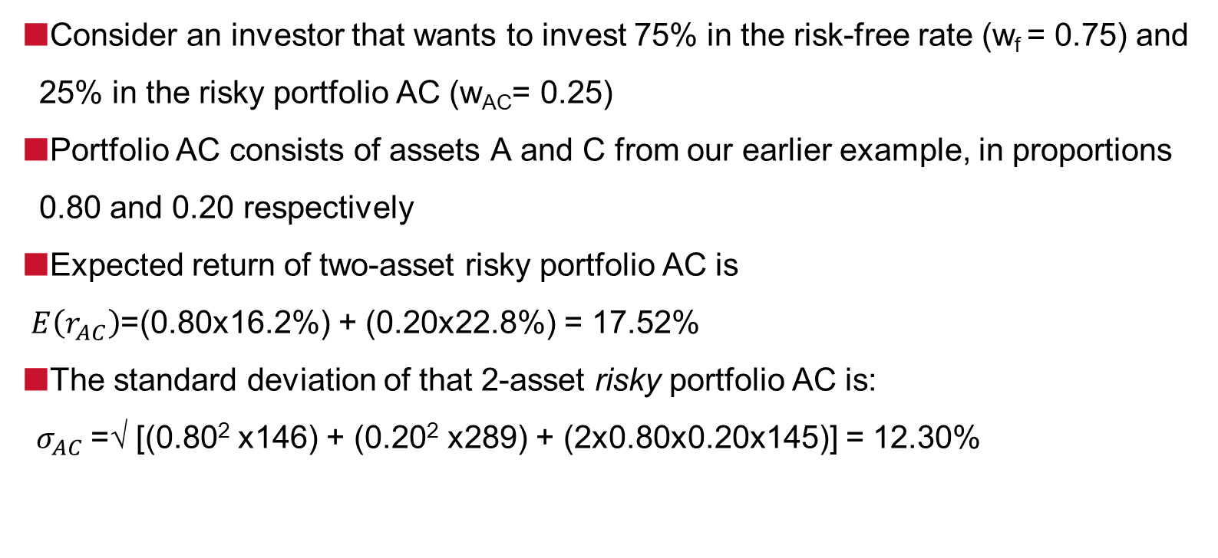
Investing in a risk-free asset and a risky portfolio: risk free lending example
Consider an investor that wants to invest 75% in the risk-free rate (w_{f} = 0.75) and 25% in the risky portfolio AC (w_{AC}= 0.25)
Portfolio AC consists of assets A and C from our earlier example, in proportions 0.80 and 0.20 respectively
Expected return of two-asset risky portfolio AC is
$E\left(r_{AC}\right)$=(0.80x16.2%) + (0.20x22.8%) = 17.52%
The standard deviation of that 2-asset risky portfolio AC is:
${ σ}_{AC}$=√ [(0.80² x146) + (0.20² x289) + (2x0.80x0.20x145)] = 12.30%

Slide 16
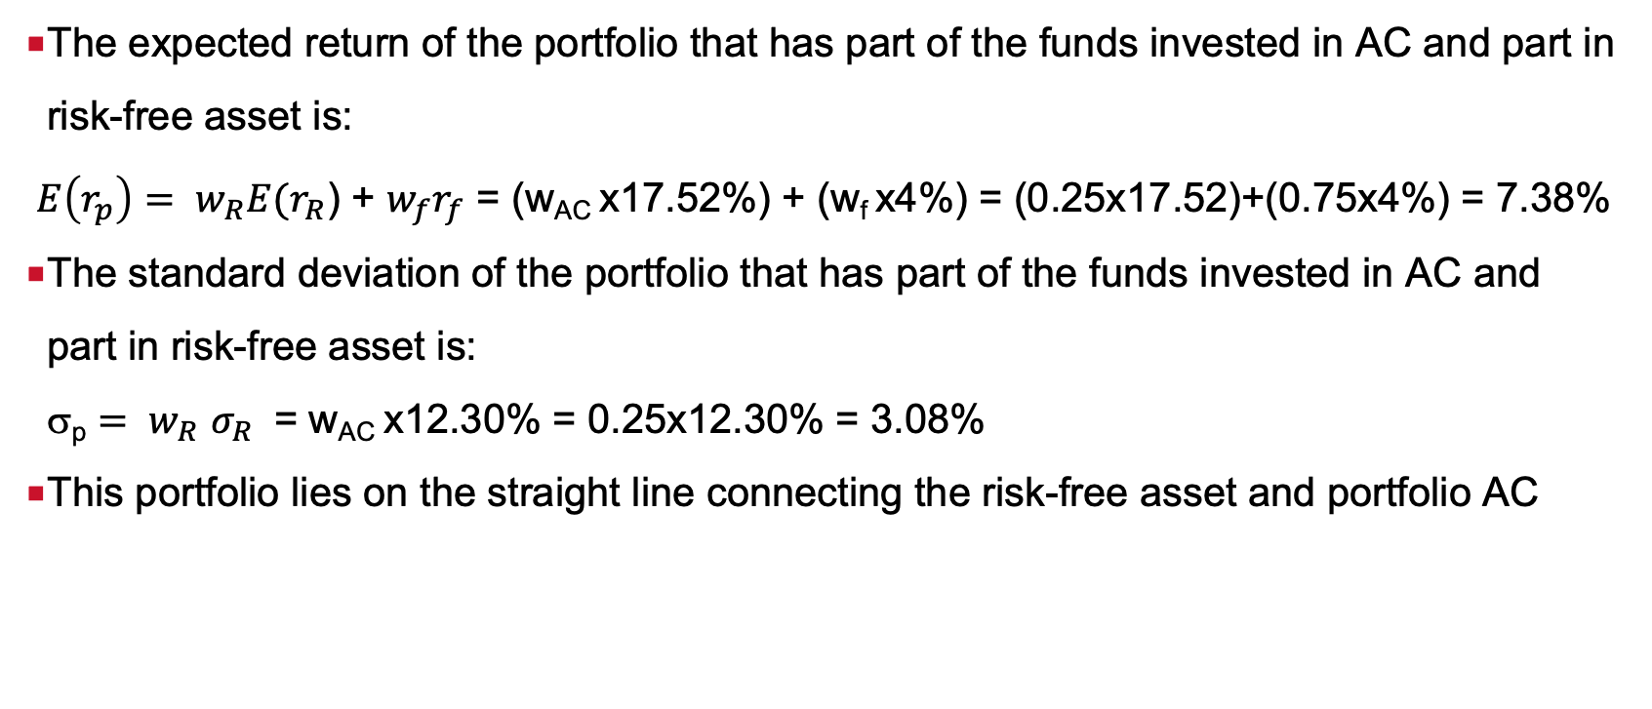
Investing in a risk-free asset and a risky portfolio R: risk-free lending example
The expected return of the portfolio that has part of the funds invested in AC and part in risk-free asset is:
${E\left(r_{p}\right)= w}_{R}{E(r}_{R}$) + $w_{f}r_{f}$ = (w_{AC} x17.52%) + (w_{f} x4%) = (0.25x17.52)+(0.75x4%) = 7.38%
The standard deviation of the portfolio that has part of the funds invested in AC and part in risk-free asset is:
σ_{p} ${= w}_{R}$ $σ_{R}$ = w_{AC} x12.30% = 0.25x12.30% = 3.08%
This portfolio lies on the straight line connecting the risk-free asset and portfolio AC

Slide 17
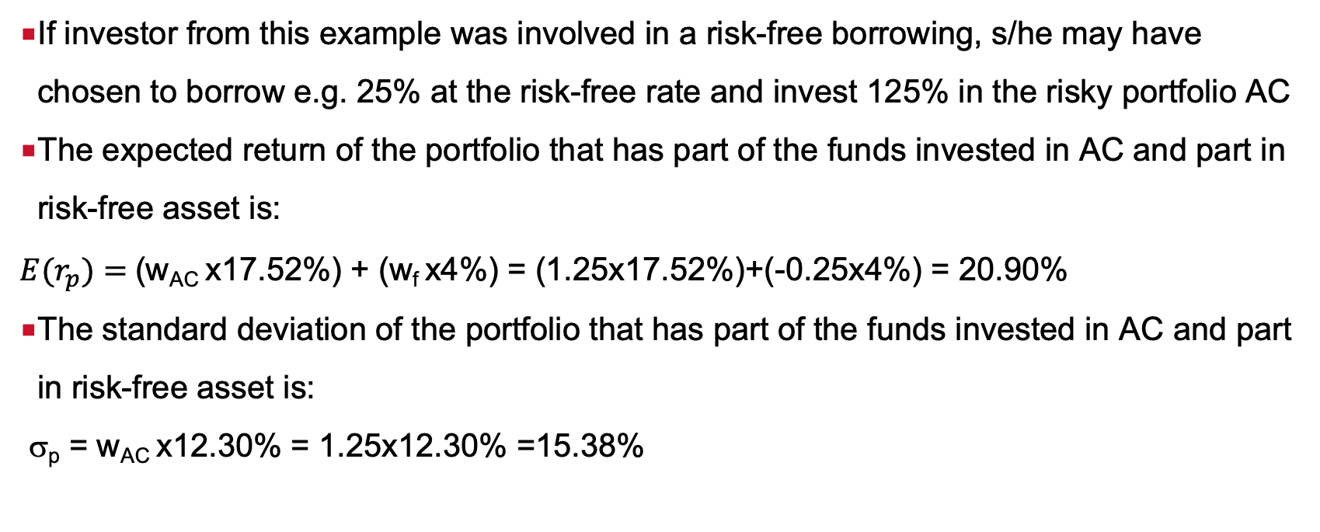
Investing in a risk-free asset and a risky portfolio R: risk-free borrowing example
If investor from this example was involved in a risk-free borrowing, s/he may have chosen to borrow e.g. 25% at the risk-free rate and invest 125% in the risky portfolio AC
The expected return of the portfolio that has part of the funds invested in AC and part in risk-free asset is:
$E(r_{p})=$(w_{AC} x17.52%) + (w_{f} x4%) = (1.25x17.52%)+(-0.25x4%) = 20.90%
The standard deviation of the portfolio that has part of the funds invested in AC and part in risk-free asset is:
σ_{p} = w_{AC} x12.30% = 1.25x12.30% =15.38%

Slide 18
Investing in a risky portfolio and a risky asset: Graph
Borrowing

Slide 19
Efficient frontiers of N assets with risk-free borrowing and lending

Slide 20
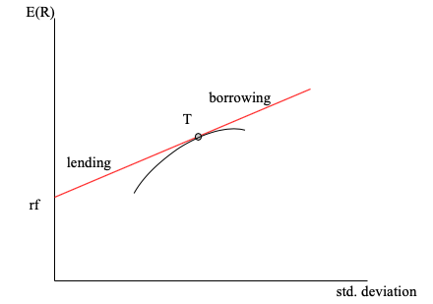
Efficient frontier: risk-free lending and borrowing at the same rate
Also called Capital Allocation Line (CAL)
Short-selling the risk-free asset and investing proceeds in the risky portfolio T results in a portfolio lying on the extension of the line connecting the risk-free rate (rf) and T, i.e. to the right from T.
When risk free borrowing is added, the efficient frontier becomes a straight line, tangent to the concave efficient frontier of risky assets
T is the only portfolio of risky assets investor can hold on this frontier
Capital Allocation Line

Slide 21
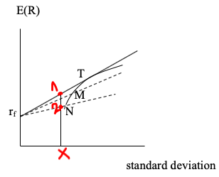
Why the linear efficient frontier (CAL) must be a tangent to the concave one?
Why not invest in portfolio M or N, which are also portfolios on the original efficient frontier of risky assets, thus having one of the dotted lines as new efficient frontiers?
For the level of risk, say X, we identify portfolio 1 on rf-T and portfolio 2 on the rf-N. Portfolio 1 has higher return than portfolio 2 for the same level of risk X, which makes it more efficient.
ALL portfolios on the tangency line rf-T and onwards from T are superior to portfolios below that line so they must represent the efficient frontier.
Capital Allocation Line

Slide 22
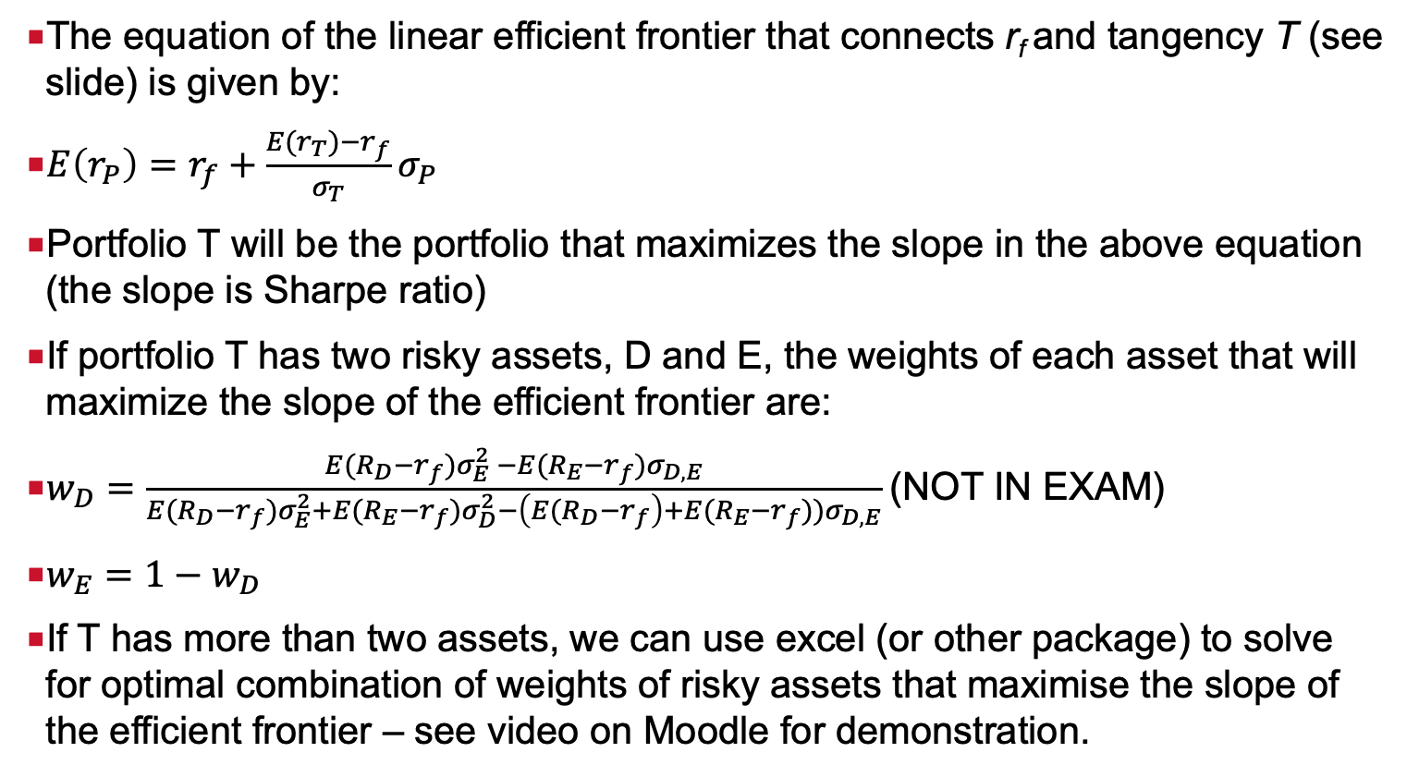
Weights of risky assets in the optimal tangency portfolio T
The equation of the linear efficient frontier that connects r_{f} and tangency T (see slide) is given by:
$E\left(r_{P}\right)=r_{f}+\frac{E(r_{T})−r_{f}}{σ_{T}}σ_{P}$
Portfolio T will be the portfolio that maximizes the slope in the above equation (the slope is Sharpe ratio)
If portfolio T has two risky assets, D and E, the weights of each asset that will maximize the slope of the efficient frontier are:
$w_{D}=\frac{E{(R}_{D}−r_{f})σ_{E}^{2} −E(R_{E}−r_{f})σ_{D, E}}{E{(R}_{D}−r_{f})σ_{E}^{2}+E{(R}_{E}−r_{f})σ_{D}^{2}−\left(E{(R}_{D}−r_{f}\right)+E(R_{E}−r_{f}))σ_{D, E}}$(NOT IN EXAM)
$w_{E}=1−w_{D}$
If T has more than two assets, we can use excel (or other package) to solve for optimal combination of weights of risky assets that maximise the slope of the efficient frontier – see video on Moodle for demonstration.

Slide 23
Efficient frontiers in reality

Slide 24
Are all investors facing the same efficient frontier?
Different investors will face different set of risky assets available to them
  Implication: they may face completely different efficient frontier of risky assets (concave efficient frontier): small cap stocks only, value stocks only, global frontier etc.
In addition, we have assumed for simplicity that the risk-free asset in the analysis is Treasury bill, say 3 months Treasury bill.
In reality, the 3 months Treasury bill may not be a risk-free asset for every investor
  Implication: investors have different assets they consider risk-free

Slide 25
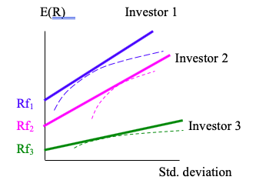
Are all investors facing the same efficient frontier (CAL)?
Different investors face different efficient frontiers

Slide 26
Efficient frontier with different borrowing and lending rates
Unlikely that in reality an investor would be allowed to lend and borrow at the same rate
Borrowing rate will be higher than the lending rate
Borrower (investor) is assumed to be less credit worthy than the government (i.e. the issuer of the Treasury bill or any other Government bond that investor uses as a risk-free asset in the risk-free lending process)
How does that affect the efficient frontier?

Slide 27
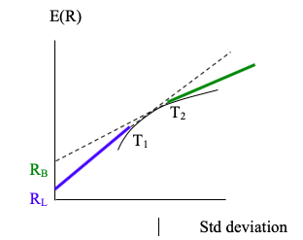
Efficient frontier with different borrowing and lending rates
Efficient frontier that takes into account higher borrowing than lending rates is constructed by applying:
a lending line (at which we are not allowed to borrow) and
a borrowing line (at which we are not allowed to lend) to the original concave efficient set of risky assets
Two tangency portfolios T₁ and T₂

Slide 28
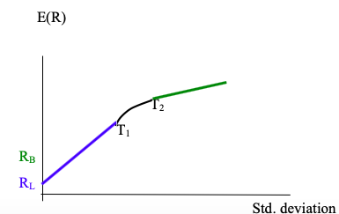
Efficient frontier with different borrowing and lending rates
Efficient frontier: the straight line between the lending rate (R_{L}) and tangency portfolio T₁, the concave segment between T₁ and T₂ and the straight line from T2 onwards.
Segment R_{L}-T₁ : lending only
Segment to the right of T2: borrowing only
Concave segment between and inclusive of the two tangency portfolios T1 and T2: investor invests in risky assets only

Slide 29
References
Relevant parts of Chapter 5 “Delineating Efficient Portfolios”, and Chapter 11 “How to select among portfolios on opportunity set” in Elton, Gruber, Miles and Goetzmann “ Modern Portfolio Theory and Investment Analysis”
Relevant parts of Chapter 6 “Capital Allocation in Risky Assets’ and Chapter 7 “Optimal Risky Portfolios”, in Bodie, Kane and Marcus “Investments”

Slide 30
Contact: natasha.todorovic.1@city.ac.uk
Room 4031
Bayes Business School, Bunhill Row, Level 4

